Slide 1
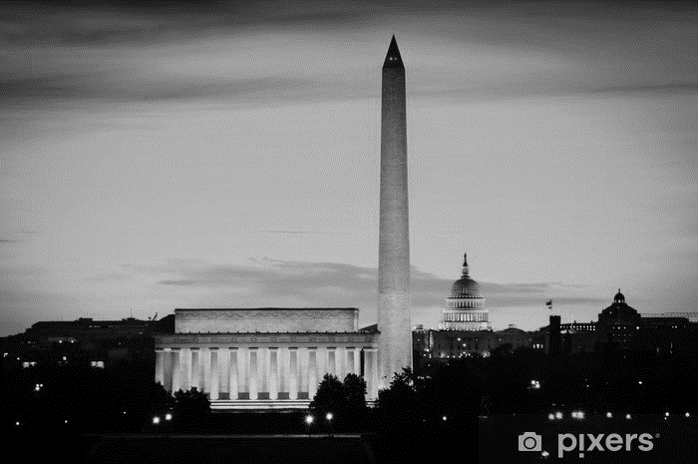
CRES National Survey
February 28, 2022
Online National Survey of 1,000 Registered Voters
Conducted February 4-8, 2022
Credibility interval: +3.53%
PREPARED BY:
Neil Newhouse, Partner

Slide 2
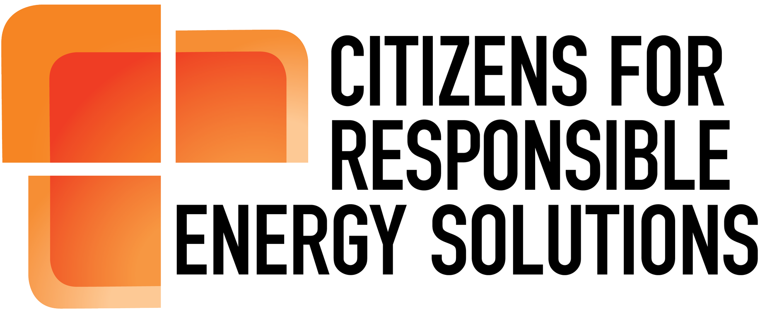
Table of Contents
Key Findings (3-4)
The Political Environment (5-6)
The Country’s Issue Agenda (7)
Attitudes Toward Climate Change (8-12)
Government’s Role (13-14)
Policies to Reduce Emissions (15-17)
Attitudes Toward Natural Gas (18-21)
Vote Determinants (22-27)
U.S. Energy Independence (28-29)

Slide 3
KEY FINDINGS
Overall, Americans are divided along party lines on the issues important to them, but the economy is a top issue for Republicans and Democrats. Energy issues enjoy the least partisan divide while environmental issues, such as climate change, are the most partisan. This presents opportunities for Republicans to win over independent voters by tying economic, energy and environmental issues together—without alienating their base.
Over the past year, there has been an increase in the number of Americans who say human-caused pollution contributes to climate change—from 79 percent to 82 percent—and say their lives have been impacted by climate change—from 39 percent to 53 percent. This reflects upticks in attitudes across partisan, ideological and generational lines.
In greater numbers year-over-year, voters support the federal government taking more action to address climate change, which includes accelerating the development and use of clean energy.

Slide 4
KEY FINDINGS
Americans across party lines overwhelmingly support “common-sense” ideas to expand the government's commitment to clean energy—ranging from tax incentives to reducing regulatory red tape to holding foreign countries to their emission-reduction commitments.
Americans believe natural gas is affordable, plentiful, reliable, clean and will be an important part of building an energy-independent, “all of the above” energy mix for decades to come. Independent and Republican voters oppose policies taxing or eliminating natural gas.
Voters are more likely to support a candidate who endorses policies addressing climate change and clean energy; that’s especially the case for key swing 2022 constituencies.
Following the cancellation of the Keystone XL pipeline and other actions, a mere 16 percent of voters believe the United States is energy independent—a reality making headlines as the situation between Russia and Ukraine unfolds.

Slide 5
Voters aren’t pleased with the direction of the country or their political leaders.
Overall
Mood of Country
Pres. Job Approval
Congress Job Approval
-35
-84
-43
+17
-11
-45
APP
DISAPP
RD
WT
RD
WT
RD
WT
RD
WT
Approve
Disapprove
Approve
Disapprove
*RD: Right Direction, WT: Wrong Track
Generally speaking, would you say that things in the country are going in the right direction, or have they pretty seriously gotten off on the wrong track?/Do you strongly approve, somewhat approve, somewhat disapprove, or strongly disapprove of the job Joe Biden is doing as President?

Slide 6
The generic congressional ballot reflects other recent polling—it’s a dead heat.
RCP Average
48%-44%
-7
-2
+85
+2
-89
66%
Def
67%
Def
42%
Strongly
36%
Def
31%
Def
30%
Def
30%
Def
13%
Def
GOP
Candidate
DEM
Candidate
GOP
Candidate
DEM
Candidate
GOP
Candidate
GOP
Candidate
DEM
Candidate
DEM
Candidate
DEM
GOP
And, if the election for U.S. Congress were being held today, for whom would you vote for... the Republican candidate .... OR .... the Democratic candidate ...from your district?

Slide 7
Energy is the least partisan–providing opportunity to effectively message independent voters.
GOP (42%) | IND (17%) | DEM (41%)
74% | 59% | 55%
47% | 58% | 67%
59% | 46% | 44%
47% | 44% | 46%
38% | 35% | 47%
59% | 34% | 26%
20% | 42% | 60%
32% | 30% | 43%
%Extremely Important
Economic Issues - like taxes, wages, jobs, inflation, unemployment, spending, supply chain management
Total
Health Care Issues - like COVID-19, the cost of health care, prescription drugs, health insurance
National Security Issues - like terrorism, foreign policy, cybersecurity
Energy Issues - like cost of energy (electricity, gasoline, and home heating) and energy reliability
Seniors and Aging Issues - like Medicare and Social Security, long term and home care
Immigration Issues - like border security
Environmental issues - like clean air, clean water, climate change, and clean energy
Education Issues - like school standards, class sizes, school choice, and student loans
Thinking about issues that are facing the country, how important do you believe each of the following issues are for the country's political leaders to address?

Slide 8
There has been an increase in the number of Americans who believe human-caused pollution contributes to climate change.
+63
+66
+70
And, do you believe that human-caused pollution contributes to climate change?

Slide 9
Independents–key to winning in 2022—overwhelmingly believe human-caused pollution contributes to climate change.
+45
+76
+91
73%
Definitely
51%
Definitely
28%
Definitely
Yes
No
Yes
No
Yes
No
And, do you believe that human-caused pollution contributes to climate change?

Slide 10
In just one year, there was a 14 percent jump in the number of Americans who say their lives have been affected by climate change.
44%
Definitely
20%
Definitely
17%
Definitely
15%
Definitely
Do you feel your life has directly been affected by climate change?

Slide 11
That increase happened across party lines—13 percent increase in Republicans and 15 percent increase in independents.
January 2021
February 2022
-45
-6
+29
-26
+14
+57
No
Yes
No
No
No
No
No
Yes
Yes
Yes
Yes
Yes
Do you feel your life has directly been affected by climate change?

Slide 12
Older voters are now more likely to say their lives have been impacted– a 22 percent jump in 55–64-year-olds and 17 percent increase for those 65+.
January 2021
+15
+19
-9
-28
-25
February 2022
+25
+24
+20
+9
-0-
Do you feel your life has directly been affected by climate change?

Slide 13
Voters remain consistently in favor of the federal government taking action to accelerate the development and use of clean energy in the country.
%Support - %Oppose | %Support
Strong GOP | 49% - 41%
GOP Primary Voters | 59% - 31%
+30
+58
+90
66%
Strongly
40%
Strg
40%
Strg
34%
Strongly
17%
Strongly
14%
Strongly
Support
Oppose
Support
Oppose
Support
Oppose
Do you support or oppose the federal government taking action to accelerate the development and use of clean energy in the United States?

Slide 14
Voters are strongly in favor of the federal government taking more action to address climate change.
More
Less
Same
More
Less
Same
More
Less
Same
More
Less
Same
And, do you believe the federal government should be doing more or less than it is now to address the issue of climate change?

Slide 15
Six emission-reducing policies have clear support across party lines.
Policy | Total | GOP (42%) | IND (17%) | DEM (41%)
Providing tax credits or direct assistance to homeowners to replace home appliances and windows with more energy efficient models. | 87% | 79% | 85% | 95%
Holding foreign countries, including China, responsible for their emission reduction pledges so that they are comparable to the United States' efforts. | 86% | 82% | 83% | 92%
Providing tax credits for individuals and companies that invest in clean energy generation in the US. | 85% | 76% | 84% | 95%
Reducing regulatory and bureaucratic obstacles that slow the permitting process to safely use new energy technologies and build clean energy infrastructure. | 82% | 75% | 85% | 89%
Providing tax incentives to businesses to capture carbon emissions. | 81% | 73% | 76% | 91%
Increasing federal government investment in research and development to accelerate the adoption of battery storage technologies that allow for greater use of renewable energy when the sun is not shining or the wind is not blowing. | 81% | 68% | 86% | 92%
Please read the following list of policies that supporters have proposed to help expand the federal government's commitment to clean energy. After you read each one, please indicate whether you strongly favor, somewhat favor, somewhat oppose or strongly oppose that policy.

Slide 16
Government mandates and tax increases have significantly lower support.
Policy | Total | GOP (42%) | IND (17%) | DEM (41%)
Put in place a federal mandate to eliminate the use of all energy produced from fossil fuels by 2030. | 54% | 31% | 53% | 78%
Increase taxes on the production of oil, gas, and natural gas to pay for programs to reduce emissions. | 48% | 25% | 42% | 73%
Stop all new natural gas exploration in the country. | 42% | 23% | 37% | 63%
Please read the following list of policies that supporters have proposed to help expand the federal government's commitment to clean energy. After you read each one, please indicate whether you strongly favor, somewhat favor, somewhat oppose or strongly oppose that policy.

Slide 17
These six policies have strong support among key 2022 target voters.
Policy | Total | Hispanic (10%) | White Suburb. Women (15%) | Moderates (32%) | Women College+ (14%) | IND Women (8%) | GOP Primary Voters (35%) | Generic Ballot Undec (16%)
Providing tax credits or direct assistance to homeowners to replace home appliances and windows with more energy efficient models. | 87% | 95% | 89% | 91% | 93% | 86% | 77% | 90%
Holding foreign countries, including China, responsible for their emission reduction pledges so that they are comparable to the United States' efforts. | 86% | 90% | 84% | 86% | 87% | 76% | 84% | 78%
Providing tax credits for individuals and companies that invest in clean energy generation in the US. | 85% | 88% | 88% | 89% | 90% | 83% | 73% | 86%
Reducing regulatory and bureaucratic obstacles that slow the permitting process to safely use new energy technologies and build clean energy infrastructure. | 82% | 79% | 81% | 83% | 77% | 78% | 73% | 80%
Providing tax incentives to businesses to capture carbon emissions. | 81% | 79% | 84% | 85% | 85% | 79% | 71% | 77%
Increasing federal government investment in research and development to accelerate the adoption of battery storage technologies that allow for greater use of renewable energy when the sun is not shining or the wind is not blowing. | 81% | 88% | 82% | 88% | 88% | 86% | 67% | 85%
Put in place a federal mandate to eliminate the use of all energy produced from fossil fuels by 2030. | 54% | 63% | 59% | 60% | 61% | 63% | 29% | 58%
Increase taxes on the production of oil, gas, and natural gas to pay for programs to reduce emissions. | 48% | 51% | 47% | 51% | 52% | 42% | 23% | 45%
Stop all new natural gas exploration in the country. | 42% | 54% | 47% | 45% | 49% | 53% | 23% | 40%
Please read the following list of policies that supporters have proposed to help expand the federal government's commitment to clean energy. After you read each one, please indicate whether you strongly favor, somewhat favor, somewhat oppose or strongly oppose that policy.

Slide 18
A large majority of Americans say natural gas is reliable, affordable, plentiful, clean and will be part of the U.S. energy mix for decades to come.
Energy from Natural Gas
For each of the following energy sources, please indicate whether you believe each of the below characteristics accurately describes that energy source…

Slide 19
Half of voters oppose banning the production of natural gas in the country—including 52 percent of independents.
-47
-19
+22
48%
Strongly
29%
Strg
28%
Strongly
18%
Strg
21%
Strongly
15%
Strg
12%
Strg
10%
Strongly
Support
Oppose
Support
Oppose
Support
Oppose
In the push for clean energy, do you support or oppose efforts to ban the production of natural gas in this country?

Slide 20
An even larger majority–53 percent–oppose banning use of natural gas for cooking or heating in the construction of new homes.
-49
-15
+9
55%
Strg
33%
Strg
28%
Strg
18%
Strg
10%
Strg
12%
Strg
Support
Oppose
Not Sure
Support
Oppose
Support
Oppose
Support
Oppose
And, do you support or oppose efforts to ban the use of natural gas for cooking or heating uses in the construction of new family homes in the US?

Slide 21
When told banning natural gas would result in energy shortages and rising prices, opposition increases to 71 percent.
Of These 34% Who Initially Support Banning Natural Gas for New Family Homes:
Support-Oppose
And, do you support or oppose efforts to ban the use of natural gas for cooking or heating uses in the construction of new family homes in the US? | 34%
Holding foreign countries, including China, responsible for their emission reduction pledges so that they are comparable to the United States' efforts. | 53%
Would you sill support banning the use of natural gas if you knew that one-third of the energy used by Americans currently comes from natural gas…
These reversals account for 18 percent of respondents. Making it a total 71 percent of Americans oppose banning natural gas for cooking and in new home construction.
Would you still support banning the use of natural gas if you knew that one-third of the energy used by Americans currently comes from natural gas, and banning natural gas would result in energy shortages and rising prices?

Slide 22
When voters are asked to choose between a candidate who supports financial incentives for businesses to adopt clean energy practices, and one who supports government mandates…
A candidate for Congress who believes that the federal government should provide financial incentives for US businesses to promote the use of clean energy and address climate change
...or…
A candidate for Congress who believes that the federal government should mandate that US businesses address the issue of climate change because private companies won't do it on their own?

Slide 23
The “incentives” candidate easily wins with significant support across party lines.
A candidate for Congress who believes that the federal government should provide financial incentives for US businesses to promote the use of clean energy and address climate change
...or…
A candidate for Congress who believes that the federal government should mandate that US businesses address the issue of climate change because private companies won't do it on their own
+36
+20
-6
Not Sure
Incentives
Incentives
Mandate
Mandate
Incentives
Mandate
Incentives
Mandate
Generally speaking, would you be more likely to vote for…

Slide 24
The “incentives” candidate also leads among key 2022 constituencies.
A candidate for Congress who believes that the federal government should provide financial incentives for US businesses to promote the use of clean energy and address climate change
...or…
A candidate for Congress who believes that the federal government should mandate that US businesses address the issue of climate change because private companies won't do it on their own?
+17
+11
+16
+18
Incentives
Mandate
Incentives
Mandate
Incentives
Mandate
Incentives
Mandate
Generally speaking, would you be more likely to vote for…

Slide 25
When voters are asked whether they would be more favorable to their Senator or Member of Congress if they supported government action (to reduce carbon pollution/encourage the development of clean energy)…
If your U.S. Senator or Member of Congress supported government action to reduce carbon pollution in order to combat climate change, would that give you a more favorable or less favorable impression of that elected official? (A)
If your US Senator or Member of Congress supported government action to encourage the development of clean energy in order to protect the environment and reduce air pollution, would that give you a more favorable or less favorable impression of that elected official? (B)

Slide 26
Two-thirds of voters say they would have a more favorable impression of those elected officials…
If your U.S. Senator or Member of Congress supported government action to reduce carbon pollution in order to combat climate change, would that give you a more favorable or less favorable impression of that elected official? (A)
If your US Senator or Member of Congress supported government action to encourage the development of clean energy in order to protect the environment and reduce air pollution, would that give you a more favorable or less favorable impression of that elected official? (B)
+55
+52
+60
+53
31%
Much
29%
Much
28%
Much
26%
Much
January 2021
February 2022
January 2021
February 2022

Slide 27
While support generally cuts across the aisle.
If your U.S. Senator or Member of Congress supported government action to reduce carbon pollution in order to combat climate change, would that give you a more favorable or less favorable impression of that elected official? (A)
If your US Senator or Member of Congress supported government action to encourage the development of clean energy in order to protect the environment and reduce air pollution, would that give you a more favorable or less favorable impression of that elected official? (B)
+20
+53
+85
+22
+52
+86
More
Less
More
Less
More
Less
More
Less
More
Less
More
Less

Slide 28
A mere 16 percent of voters believe the U.S. is energy independent.
-56
-55
-53
From what you may have seen or heard, do you believe that the United States is energy independent, or do you believe it is still at least somewhat dependent on energy sources from other countries?

Slide 29
Achieving energy independence with fossil fuels remains partisan.
-29
+4
+37
31%
Def
17%
Def
22%
Def
15%
Def
14%
Def
13%
Def
In order to achieve energy independence, do you believe that it can be achieved without the use of energy produced by fossil fuels here in the US like coal, oil and natural gas?

Slide 30
Neil Newhouse Partner
Phone: (703) 836-7655
Email: neil@pos.org
Twitter: @KCkid
Evan Dixon
Communications Director, CRES
Phone: (202) 893-8845
Email: edixon@cresenergy.com

